Slide 1
University Institute of Technology RGPV
A MINOR PROJECT PRESENTATION ON
WEATHER FORECATING APP
Submitted To:-
Department Of Computer Application
Project Guided By :
Mr. Jay Narayan Thakre
Assistant Professor
Submitted By:-
Aakash Namdev
MCA(3rd) Semester
0101CA211002

Slide 2
Contents
Introduction.
Features of the Project.
Tools and Technologies to be used in this project.
How To Import And Run The Project.
Frontend of project.
Conclusion

Slide 3
Weather application
Weather apps are the most popular way to instantly access forecasts, warnings and other useful weather information on our mobile phones. They provide the public with unprecedented flexibility: users choose the information they want, how they get it and how it looks.

Slide 4
Importance of weather app?
Having an up to date information about the weather helps us to take well-read decisions. These weather apps constantly update the forecasts for a day or hour or sometimes for even a minute.

Slide 5
Introduction
Weather apps constantly update the forecasts for a day or hour. This application can be simply termed as the compact weather devices, as this do not only tell about the temperature of that specific region instead this can describe the accurate time of the sunrise and sunset, the time of the rainfall, humidity levels, wind speed.

Slide 6
Features of the Project
Search Weather in Your City.
See Temperature.
See Humidity.
See Wind Speed.
Sunrise time.
Sunset time.

Slide 7
Tools and Technologies to be used in this project
Visual studio code.
Hyper text markup language(HTML).
Java Script(JS).
Application programming interface(API).
GitHub.

Slide 8
How To Import And Run The Project
Close any open projects.
From the File menu, select Import > Import from Visual Studio 6.0 Project or Import from Visual Studio .NET Project.
Use the file selector to locate a valid .dsp or .vcproj project file and click Open.
Enter a name for the new project and click OK.
Select the correct Configuration in the Configuration toolbar.
In the Project Explorer, click Settings .
Enter any specific compilation options in the Build settings and click OK.

Slide 9
How To Import And Run The Project
On GitHub.com, navigate to the main page of the repository. Under your repository name, click Actions. In the left sidebar, click the workflow you want to run. Above the list of workflow runs, select Run workflow.

Slide 10
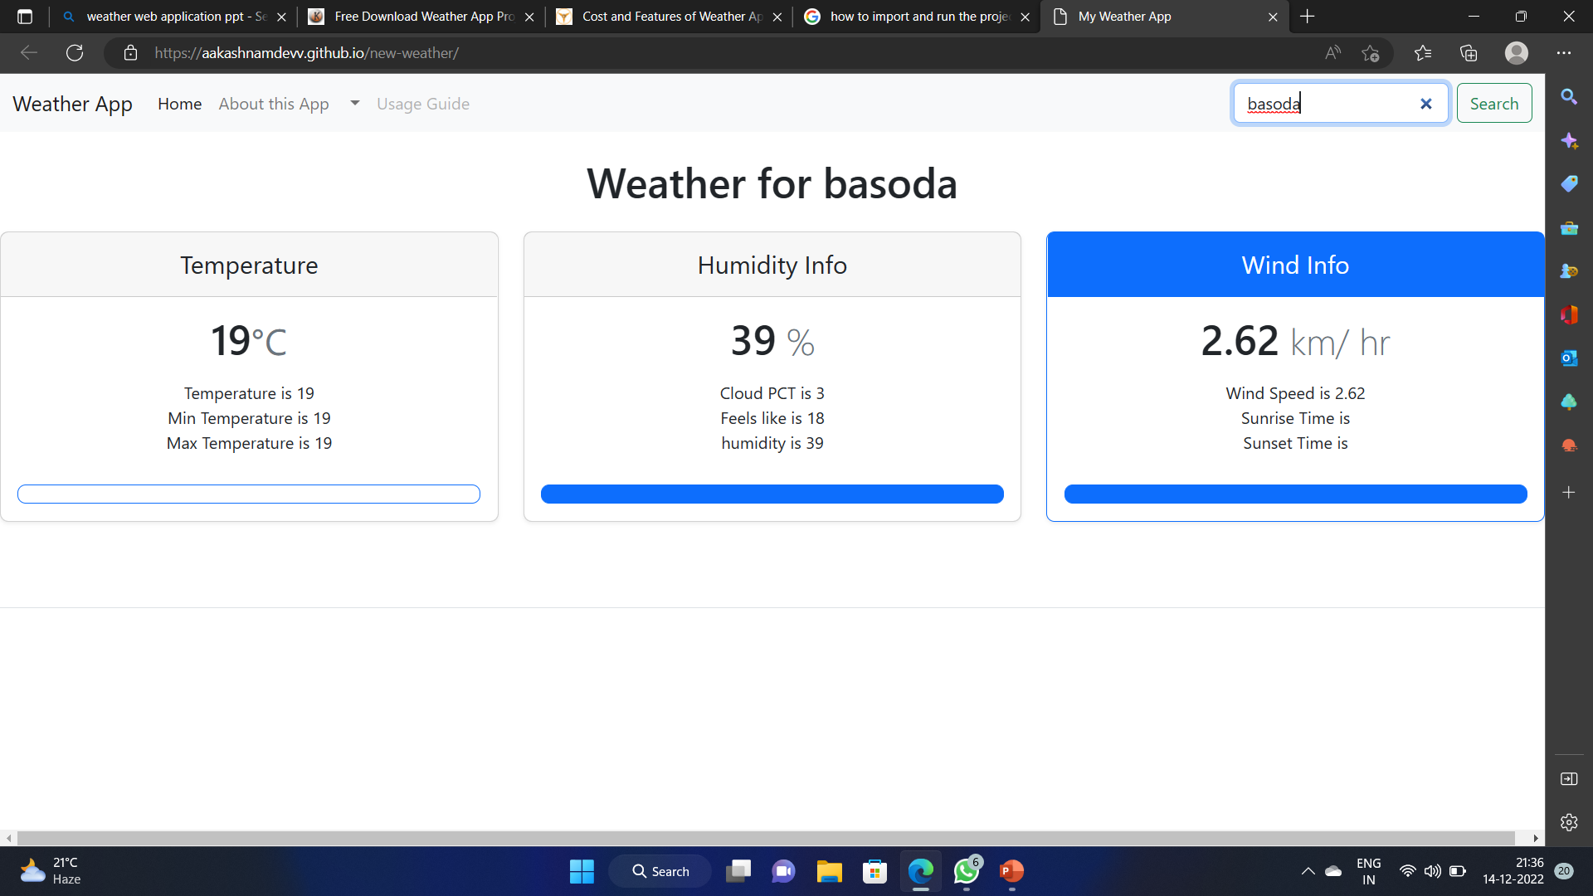

Slide 11
Conclusion
In summary, weather forecasts are increasingly accurate and useful, and their benefits extend widely across the economy. While much has been accomplished in improving weather forecasts, there remains much room for improvement.

